Slide 1

Merisis Advisors Pvt Ltd
Portfolio Management Services
SEBI Reg. No. INP000006846
PMS Offerings
August 2025
© Merisis Wealth, 2025. Private and confidential. All rights reserved.

Slide 2















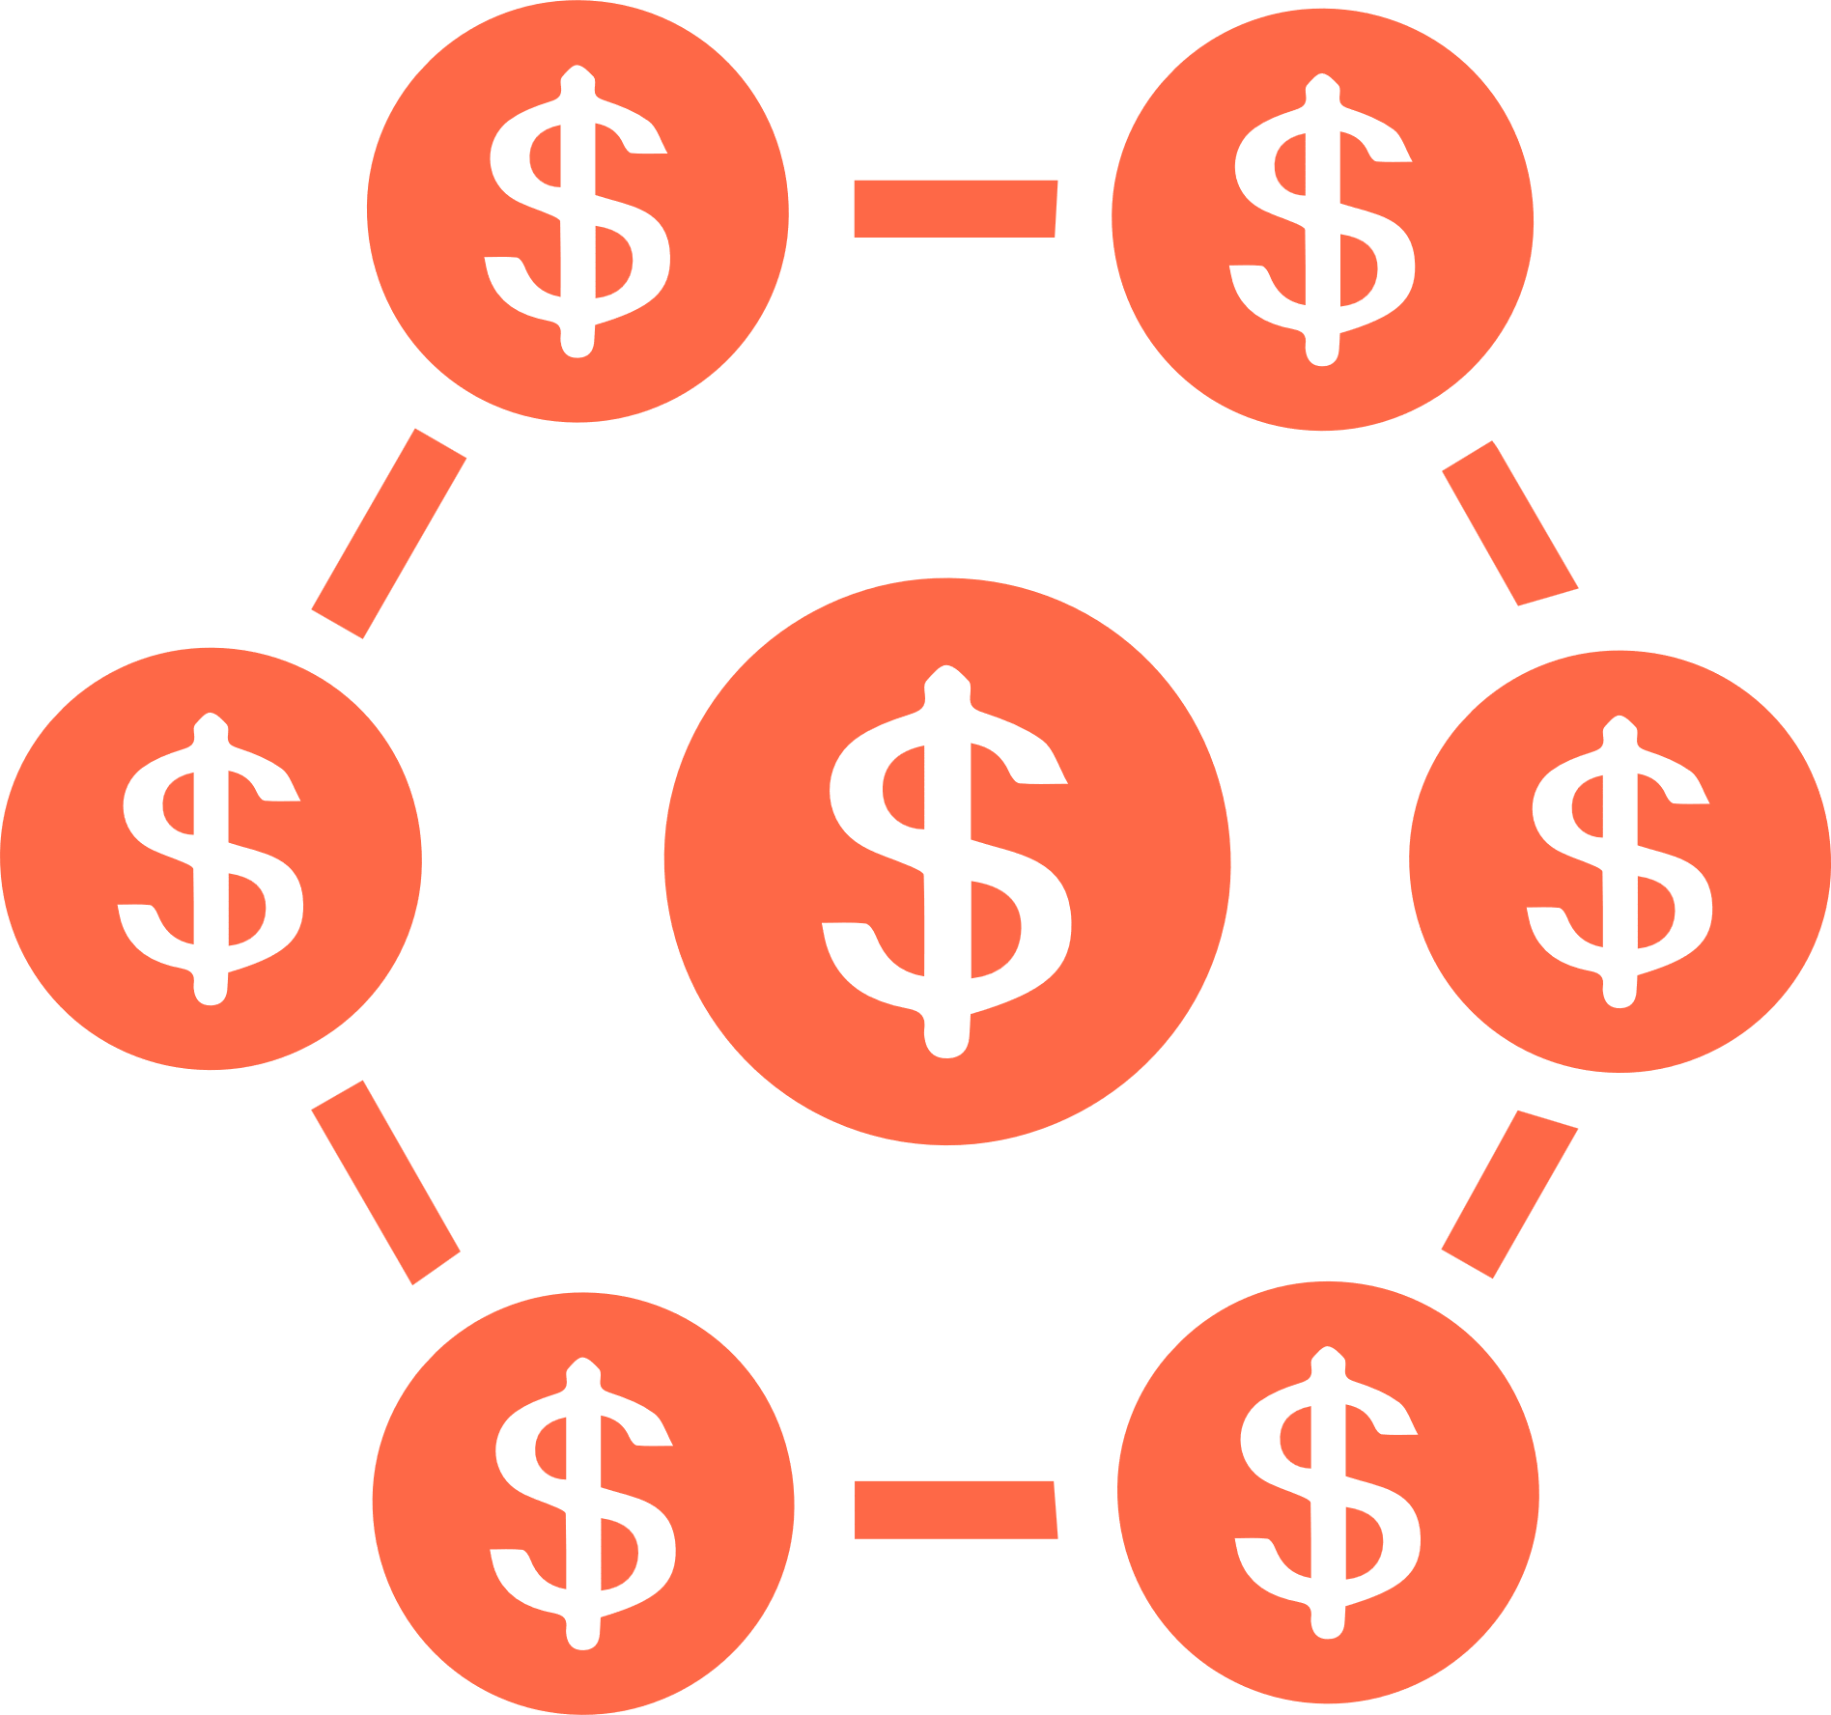




Merisis Group
at a Glance
Merisis is an Integrated Financial Advisor guiding new-age businesses and their founders on growth capital,
M&A, and wealth management
INVESTMENT BANKING
VENTURE CAPITAL / AIF
WEALTH MANAGEMENT
15 years of Success
$1Bn+ total Transaction Value
150 Cr Cat 1AIF
Wealth Management foray of Merisis Advisors focused on Entrepreneur & Corporate, Professionals & NRIs
30+ Bankers, 6 Sectors coverage
$500Mn Cross- border
Transaction Value
8 Portfolio Companies
Own PMS and AIF Products
2.2x markup in a portfolio co.
Strong team with proven track record
250+ VCs and
Strategic Partners
worked with
24+ VCs co-invested with
Established in 2009
Established in 2019
Established in 2021
Established in 2023
© Merisis Wealth, 2025. Private and confidential. All rights reserved.

Slide 3
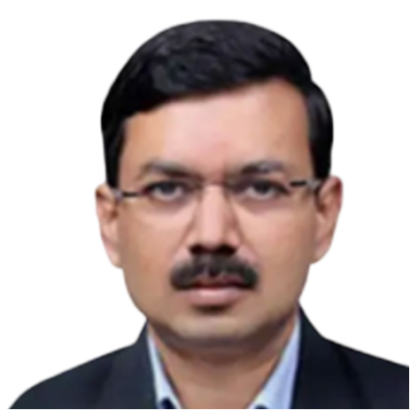
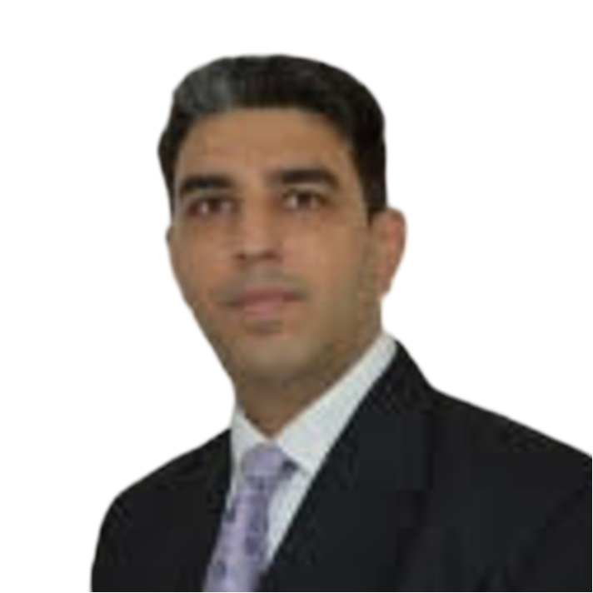



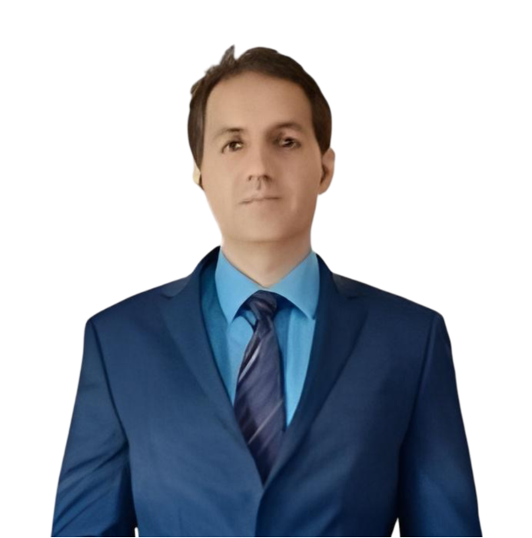
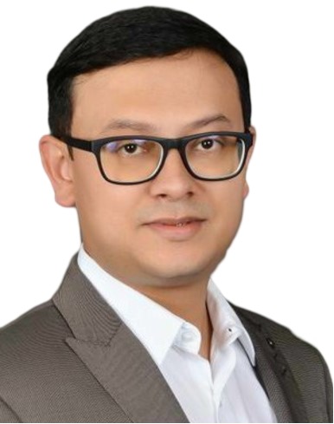




Seasoned Team with 75+ years of
Cumulative Experience
At Merisis Wealth, we have a strong leadership team with deep domain expertise and 75+ years of cumulative industry experience.
Indian & Foreign Banks
Fazal Ahad,
CFA
Ruchir Kapoor
Managing Director –
Merisis Group
Managing Director
Merisis Wealth
Wealth Management
Brokerages
Naresh Bulchandani, CFA, CAIA
Akshay Badjate
CA
Head of Products & Investment Strategy
Fund Manager and Investment Counsellor
© Merisis Wealth, 2025. Private and confidential. All rights reserved.

Slide 4
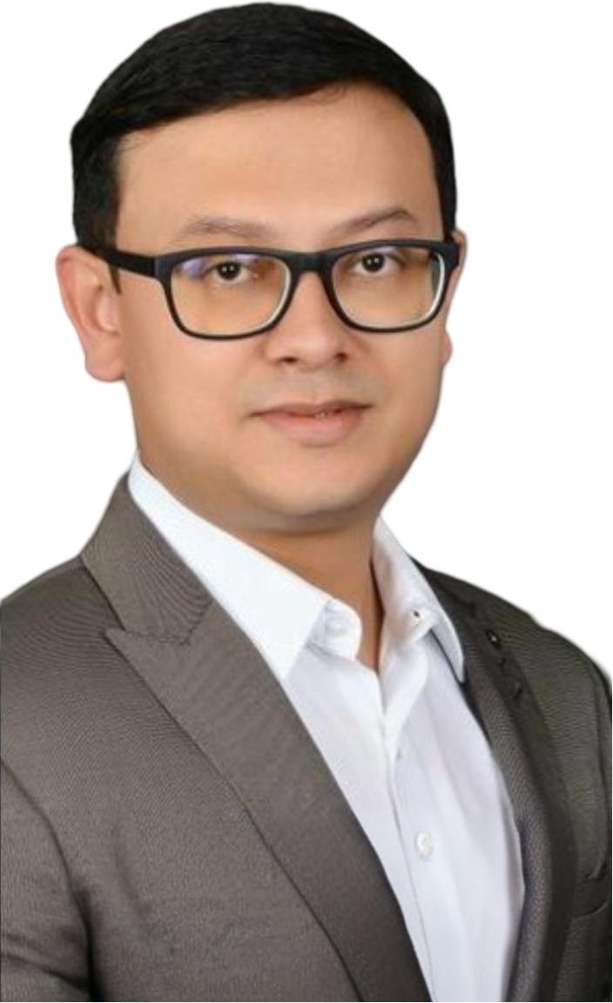



Fund Manager Profile and Past Success Stories
Akshay Badjate brings with him 19 years + of rich experience in the field of Indian Capital Markets with a focus on public markets investing.
Akshay has previously worked in leadership roles with a focus on product & investment research at early stage fintech companies. He has also worked with a host of reputed global investment banks such as JP MorganChase, Lehman Brothers / Nomura and Kotak Institutional Equities.
During his stint at Alphaniti (Now TORUS-Alphaniti) between 2019-2023, Akshay identified and built several multi-bagger investment themes which consistently figured in the top 10 in the Smallcase & PMS universe performance rankings upto January 2023.
Akshay is a Chartered Accountant by qualification and is extremely passionate about equities. While being highly data driven, Akshay adopts a long-term orientation towards both business and market cycles. His favorite book is "Capital Returns" which has deeply influenced his investment thought process.
© Merisis Wealth, 2025. Private and confidential. All rights reserved.

Slide 5


Merisis Multicap Portfolio
“Growth and Value are two sides of the same coin. The coin is Momentum. The side facing up simply tells us which way momentum is currently flowing”
© Merisis Wealth, 2025. Private and confidential. All rights reserved.

Slide 6





Our Investment Philosophy
Investing in non-consensus ideas with a margin of safety
Mean Reversion
Investment Philosophy
Period of prolonged low returns gives way to period of high super normal returns
Adaptive Investing – Agnostic Approach – Ahead of the Curve
Differentiated Positioning
Room to adopt counter cyclical approach
Adaptive Investing
Margin of Safety
Actively managed portfolios based on underlying market conditions
“Heads I gain a lot; Tails I don’t loose much”
Focus on Asymmetry
Investment opportunities with asymmetric risk reward setups & positive optionality
Investment Philosophy
Adaptive Investing – Agnostic Approach – Ahead of the Curve
© Merisis Wealth, 2025. Private and confidential. All rights reserved.

Slide 7



Merisis Multicap Positioning
Actively Managed, Adaptive Investment Process, Non-consensus, Value centric approach
Style
Addressable Universe
Top 1000 Cos. by Market Cap.
Bias towards Mid & Small cap Cos.
Style
Universe
2/3rd Cos. have outperformed Nifty 500 over last 3 and 5 years in this segment
Why
Why
© Merisis Wealth, 2025. Private and confidential. All rights reserved.

Slide 8







Our Approach
Differentiated Portfolio Construction
Dynamic Investment Approach
Unique combination of quantitative and fundamental technique
Low threshold for mistakes
Strong Past Track Record of Fund Manager
Customization of Portfolios

Slide 9
Merisis SmartBlend ETF Strategy
“A countercyclical approach towards generating market agnostic returns”
© Merisis Wealth, 2025. Private and confidential. All rights reserved.

Slide 10
Why Multi Asset Approach?
The beauty of negative correlation
Asset Class Yearly Performance
Dec-13 | Dec-14 | Dec-15 | Dec-16 | Dec-17 | Dec-18 | Dec-19 | Dec-20 | Dec-21 | Dec-22 | Dec-23 | Dec-24
Global Equity | Domestic Equity | Bond Index | Crude Oil | Domestic Equity | Bond Index | Crude Oil | Silver | Crude Oil | Crude Oil | Global Equity | Global Equity
38.32% | 31.39% | 8.82% | 45.41% | 28.65% | 5.91% | 36.52% | 47.83% | 54.51% | 6.02% | 43.42% | 28.64%
Bond Index | Global Equity | Global Equity | Silver | Global Equity | Domestic Equity | Global Equity | Global Equity | Domestic Equity | Domestic Equity | Domestic Equity | Gold
7.66% | 13.40% | 5.73% | 15.21% | 28.24% | 3.15% | 35.23% | 43.64% | 24.12% | 4.33% | 20.03% | 27.21%
Domestic Equity | Bond Index | Domestic Equity | Bond Index | Crude Oil | Gold | Gold | Gold | Global Equity | Bond Index | Gold | Silver
6.76% | 11.42% | -4.06% | 10.18% | 22.72% | -1.51% | 18.26% | 25.01% | 21.39% | 3.54% | 13.06% | 21.52%
Crude Oil | Gold | Gold | Gold | Gold | Global Equity | Silver | Domestic Equity | Bond Index | Silver | Bond Index | Domestic Equity
-0.99% | -1.78% | -10.36% | 8.54% | 13.11% | -3.88% | 15.18% | 14.90% | 4.55% | 3.00% | 7.23% | 8.80%
Gold | Silver | Silver | Global Equity | Bond Index | Silver | Domestic Equity | Bond Index | Gold | Gold | Silver | Bond Index
-28.03% | -19.32% | -11.69% | 7.50% | 6.49% | -8.65% | 12.02% | 12.01% | -3.59% | -0.22% | -0.86% | 7.64%
Silver | Crude Oil | Crude Oil | Domestic Equity | Silver | Crude Oil | Bond Index | Crude Oil | Silver | Global Equity | Crude Oil | Crude Oil
-35.96% | -49.80% | -32.23% | 3.01% | 6.35% | -24.69% | 9.98% | -26.24% | -11.72% | -33.10% | -3.64% | -4.69%
Source: ICRA

Slide 11
Why Multi Asset Approach?
Each market has it’s own unique cycle
Index | 2000-2010 | 2010-2020 | March 2020 – Sep 2024 | Sep 2024 – Feb 2025 | Last 25 Years
 | CAGR |  |  | Absolute | CAGR
NIFTY | 13% | 5% | 28% | -14% | 11%
CNXMIDCAP | 19% | 4% | 44% | -20% | 16%
CNXSMLCAP |  | 0% | 45% | -23%
US (SPX) | -2% | 8% | 19% | 3% | 6%
US (NDX) | -8% | 15% | 23% | 4% | 6%
CHINA (HSI) | 2% | 1% | -2% | 9% | 1%
GOLD | 15% | 4% | 12% | 8% | 10%
SILVER | 13% | -2% | 19% | 0% | 8%
BITCOIN |  | 281% | 66% | 33%
USDINR | 0% | 5% | 2% | 5% | 3%

Slide 12
Why Multi Asset Approach?
MAF / Hybrids vs Large Cap Equity Funds – Similar return profile at HALF the risk profile!
Std Dev
Returns
Source: Morningstar

Slide 13








Merisis SmartBlend ETF Strategy
Key Features of our Strategy
Selection strategy
We have narrowed down to a universe of ~40 unique instruments from which we will take exposure to various asset classes
Top-down asset pair relationship studied at end of every month
The selection criteria is based on extensive study of following factors, viz.,
Unique ranking system developed based on multiple factors including
Liquidity
AUM
Tracking Error
Expense Ratios under direct plan
Relative Strength between pairs
Market Breadth Analysis
Market Momentum Analysis
Rolling Returns Analysis
Market Sentiment Analysis
Market Valuation Analysis based on P/E, P/B, Earnings Yield, Dividend Yield approach
Unique counter cyclical approach towards selection of asset class
Systematic Scale up / Scale down of asset class exposure
Active rule based rebalancing approach for asset allocation and scale up / scale down
Sectoral bets will be taken typically during strong broad based trending bull market phases
© Merisis Wealth, 2025. Private and confidential. All rights reserved.

Slide 14


Merisis SmartBlend ETF Strategy
Illustrative Allocation Ranges
Asset Class | Allocation Range
Domestic Equity | 0-100%
International Equity | 0-40%
Gold | 0-30%
Silver | 0-30%
REITs / INVITs | 0-30%
Debt / Liquid | 0-60%
© Merisis Wealth, 2025. Private and confidential. All rights reserved.
www.merisiswealth.com

Slide 15







Merisis SmartBlend ETF Strategy
Why Merisis SmartBlend ETF ?
Lower cost compared to traditional MAFs /
Hybrid Funds
Active Management – Proprietary Asset Shift Strategy
Core Belief - Timing drives Alpha
Implementing unique Rolling CAGR Forward Return Probability Analysis
Proprietary & High Granular Market Valuation
Heat Maps
Unique Counter Cyclical Approach
© Merisis Wealth, 2025. Private and confidential. All rights reserved.

Slide 16



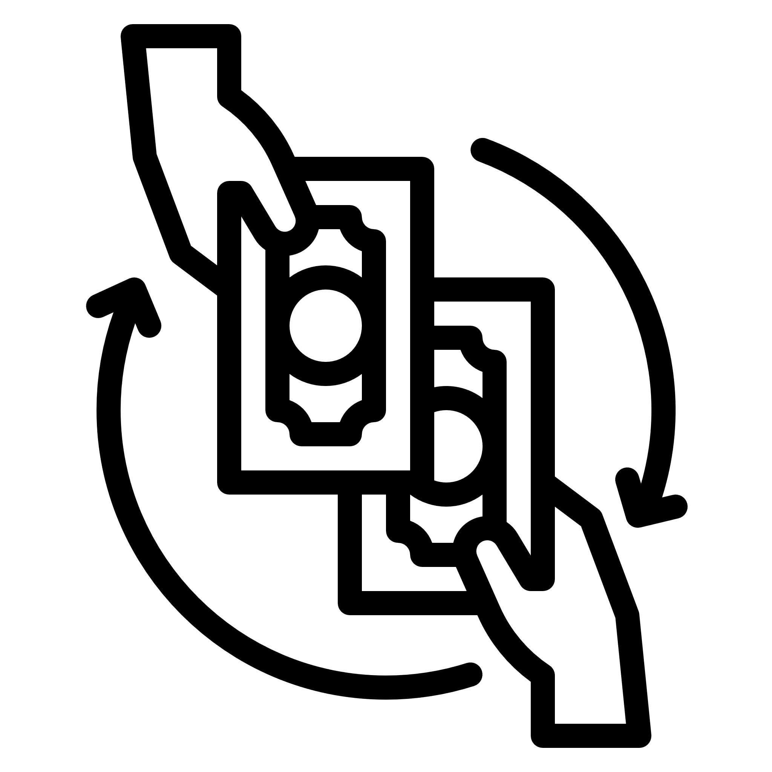
Merisis SmartBlend ETF Strategy
  Expansion of Tracking Errors
  Key Risks
  Exchange Price at significant Premium to underlying NAVs
  Model Risk
© Merisis Wealth, 2025. Private and confidential. All rights reserved.
www.merisiswealth.com

Slide 17
Merisis Catalyst Series I
“The best way to predict the future is to create it”
Peter Drucker, Father of Management
© Merisis Wealth, 2025. Private and confidential. All rights reserved.

Slide 18





Merisis Catalyst Series I – Key Features of our Strategy
Focuses on transformative opportunities that can potentially act as catalysts for long term & sustainable value creation
High Portfolio Concentration will be the center piece of our strategy
Investment strategy will largely adopt a counter cyclical / non consensus and GARP centric approach
True long-term approach – Portfolio construction aimed with Low to “No” Churn
The selection criteria is based on identifying opportunities in 2 key sub-sets, viz.,
  Turn Around Opportunities
  High Growth Opportunities
Market Cap and Sector agnostic Portfolio construction
Capex Kicker
Companies where significant capital expenditure is being undertaken or has come onstream for future growth
Regulatory Tailwinds
Companies which are set to benefit from changes in the underlying regulatory environment such as Tariff Wars, India 2030 Clean Energy Goal, Atmanirbhar Bharat Policy for Defence etc.
© Merisis Wealth, 2025. Private and confidential. All rights reserved.

Slide 19


Merisis Catalyst – Series I Positioning
The Strategy primarily focuses on turnaround companies and companies growing out of a long capex cycle
130+ companies
Companies poised for a turnaround & profitability after long pain period
Defined Universe of Top 1500 companies by Market Cap
1500 Companies
120 +
Companies
Companies set for high growth after a large capex cycle
The strategy will focus on cherry-picking 8-13 stocks out of an addressable universe of 250+ companies
© Merisis Wealth, 2025. Private and confidential. All rights reserved.
www.merisiswealth.com

Slide 20






Merisis Catalyst Series I - Snapshot
1
2
3
Focused concentrated approach with target of wealth creation
Upto 10% exposure to emerging companies from the Microcap / SME space
Unique Product Structure for benefit of investors:
  Low fixed fee
  structure
  Fixed duration of investment – our unique 3Y+1Y ensures that our investment strategy stays true to its nature
  Back ended performance fees to aid compounding of investment – charged only at end of fund life
Unique premature closure option at discretion of client if internal hurdle rates are met
Investor Benefits
  Performance fees inclusive of GST (one of the firsts in the industry)
  Capital Allocation
  Advantage
© Merisis Wealth, 2025. Private and confidential. All rights reserved.

Slide 21
Merisis Catalyst Series I: Key Risks
Highly concentrated portfolio can lead to significant portfolio drawdowns in the short to medium term which may be temporary or even permanent in nature
Key Investment Strategy
Risks
Higher portfolio volatility due to high exposure to Small Cap and Microcap segment
Illiquidity risk in Small Cap and Microcap segment
Strategy is reliant on supportive market conditions prevailing between 2028-2029, viz., the exit year for our first Series of investments in portfolio companies
© Merisis Wealth, 2025. Private and confidential. All rights reserved.

Slide 22
Merisis Catalyst Series I: Product Differentiators
 | Merisis Catalyst | Standard Equity PMS | Problem Addressed
Fund Raising Duration | Limited Period | Perpetual | Improved ability to get better entry / exits on long term investments for client monies
Fund life | Fixed Duration (1+3+1) | Perpetual | Unique ability to provide monetization opportunity to clients post completion of investment tenure
Early Monetization Optionality | Subject to Minimum hurdle rates being met client to be presented with early monetization optionality (without attracting exit loads) | No such optionality exists | Unique ability to provide early monetization opportunity to clients even prior to completion of full investment tenure
Annual Fixed Fee Structure | 1.00% - 1.25% (Incl of GST) | 1.25% – 2.50% | Annual fixed fees lower by > 50% vs Industry standards
Portfolio Benchmarking | Very Low – Uncorrelated to Benchmark | Moderate to High – Correlated to Benchmark | Focus to generate high absolute returns over a reasonably long investment horizon
Portfolio Concentration | 8 - 13 Stocks | 20-40 Stocks | Focus to generate significant absolute returns by focusing on pure bottom-up stock picking
Performance Fee | Performance Fee Charged at end of Tenure | Performance Fee Charged Annually | Unique feature in the PMS industry – Back ended performance fee aids in higher compounding of portfolio
GST Levy on Performance Fee | Performance Fee inclusive of GST | Performance Fee exclusive of GST | Will potentially save clients > 200bps in terms of cumulative costs for clients
© Merisis Wealth, 2025. Private and confidential. All rights reserved.

Slide 23
All Strategies – Snapshot Key Features
  Key Features
Scheme Name | Merisis SmartBlend ETF | Merisis Catalyst Series I | Merisis Multicap
Benchmark | CRISIL Hybrid 35+65 - Aggressive TR INR | BSE 500 TRI | BSE 500 TRI
Objective | Capital Appreciation | Capital Appreciation | Capital Appreciation
Investment Horizon | +2 Years | +4 Years | +3 Years
Ticket Size | INR 50 Lacs | INR 1Crore | INR 1 Crore
Client Risk Category | Balanced | Growth | Growth
© Merisis Wealth, 2025. Private and confidential. All rights reserved.

Slide 24
Merisis SmartBlend ETF – Fee Structure
Client Investment Commitment | Upto INR 2 Crores | Above INR 2 Crores
Annual Management Fee | 1.00% p.a. | 0.75% p.a.
Exit Load | 0.50% Exit Load up to 181 Days | 0.50% Exit Load upto 367 Days
Performance Fee | 20% Outperformance over 10% Hurdle Rate charged annually | 15% Outperformance over 10% Hurdle Rate charged annually
*Fees are Inclusive of GST
© Merisis Wealth, 2025. Private and confidential. All rights reserved.

Slide 25
Merisis Catalyst Series 1 – Fee Structure
Client Investment Commitment | Upto INR 2 Crores | Above INR 2 Crores
Annual Management Fee* | 1.25% | 1.00%
Exit Load | Year 1: 3.0% Year 2: 2.0% Year 3: 1.0%
Performance Fee* | Performance Fee of 20% on an annualized hurdle rate (IRR) of 12%
Early Monetization Event | Incase of crossing an absolute IRR of 50% within a period of 24 Months from date of full deployment, client will be given an option for early exit from scheme without attracting any Exit Load
*Fees are inclusive of GST
© Merisis Wealth, 2025. Private and confidential. All rights reserved.

Slide 26
Merisis MultiCap – Fee Structure
Client Investment Commitment | Upto INR 1 Crores | Between INR 1-2 Crores | Above INR 2 Crores
Option 1: Only Fixed Fee* | 2.50% p.a. | 2.00% p.a. | 1.50% p.a.
Option 2: Fixed + Variable with Hurdle* | 2.00% p.a. + 20% over 10% Hurdle | 1.50% p.a. + 20% over 10% Hurdle | 1.25% p.a. + 20% over 10% Hurdle
Exit Load | Year 1: 2.0% Year 2: 1.0% Year 3: 0.0%
*Exclusive of GST
© Merisis Wealth, 2025. Private and confidential. All rights reserved.

Slide 27
Merisis PMS: Our Key Partners
Custodian & Fund Accounting
Brokers
Compliances & Audit
    HDFC Bank
    Megha Kyal & Associates
    Nuvama, Ambit
Digital Onboarding Partner
Back Office / Order Management
    CAMS
    WealthSpectrum
© Merisis Wealth, 2025. Private and confidential. All rights reserved.

Slide 28
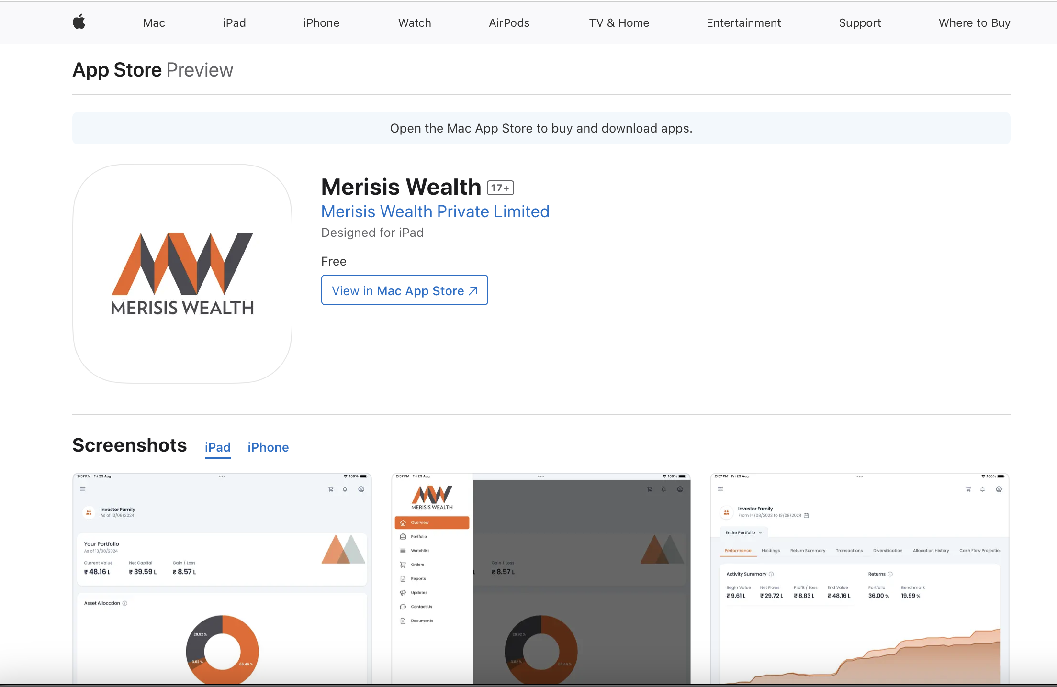
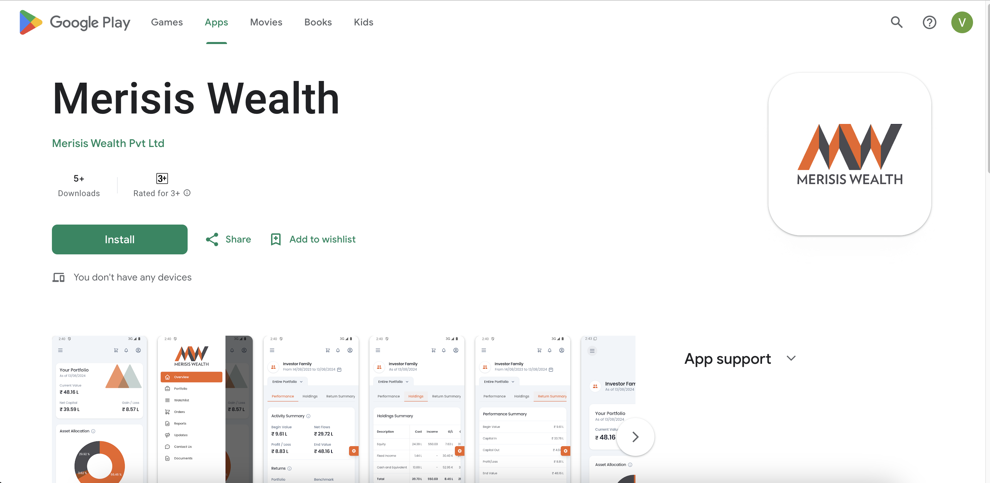
Customer Dashboards
Merisis Wealth App live on AppStore and Play Store
Live on Merisis App – PMS/Third Party Products (PMS/AIF) Wealth Products
Digital Onboarding – Merisis Multicap Portfolio via CAMS portal
Testing of the Account Aggregator – CAMS and FINVU
Portfolio Screening of Client’s portfolio using Wealthspectrum – eCAS upload (Non-Merisis Holdings)
© Merisis Wealth, 2025. Private and confidential. All rights reserved.

Slide 29
Disclaimer
Merisis Wealth Pvt. Ltd.| Corporate address – 504, 5th Floor, One BKC, Bandra Kurla Complex, Bandra East, Mumbai, Maharashtra 400051| ARN - 220145 | CIN - U52392MH2005PTC376253 | GST No. - 27AACCC8041L2ZH | Merisis Advisors Private Limited (“MAPL”) is registered under SEBI (Portfolio Managers) Regulations, 1993 as a Portfolio Manager vide Registration No. INP000006846 | Principal Officer & Managing Director – Akshay Badjate (akshay@merisis .in)
Disclaimer: Performance of the promoter or the schemes of Merisis Advisors Private Limited (MAPL) have no bearing on the expected performance of the Portfolio Manager. Past performance of the promoter and its affiliates or the Portfolio Manager is not in any manner indicative of the future performance of the Portfolio Manager and may not necessarily provide a basis of comparison. Any past or current performance related information provided in this document is not verified by SEBI. The information contained in this deck is not intended for any person who is a resident of the United States of America or a resident of a jurisdiction, the laws of which impose a prohibition on soliciting the advisory business in that jurisdiction without going through the registration requirements and/or prohibit the use of any information contained in this deck.
Risk Factors: Merisis Advisors Private Limited is not liable or responsible for any loss or shortfall resulting from the operation of the scheme. This document represents the views of Merisis Advisors Private Limited and must not be taken as the basis for an investment decision. Neither Merisis Advisors Private Limited nor its affiliates, it’s Directors or associates shall be liable for any damages including lost revenue or lost profits that may arise from the use of the information contained herein. No representation or warranty is made as to the accuracy, completeness or fairness of the information and opinions contained herein. The Portfolio Manager reserves the right to make modifications and alterations to this statement as may be required from time to time. Investments in securities are subject to market risk. Investors are encouraged to read all related documents or consult their investment advisor before making any financial decisions. Investments in the securities market are subject to market risks. Read all the related documents carefully before investing. Registration granted by SEBI, and the certification from the National Institute of Securities Markets (NISM) in no way guarantees the performance of the intermediary or provide any assurance of returns to investors
© Merisis Wealth, 2025. Private and confidential. All rights reserved.

Slide 30


For Further Queries, Contact Us
Naresh Bulchandani, CFA, CAIA
Head – Products & Investment Strategy
naresh@merisis.in
+91 98219 50005
Ruchir Kapoor
Managing Director – Merisis Wealth
ruchir@merisis.in
+91 98670 05923
© Merisis Wealth, 2025. Private and confidential. All rights reserved.

